Slide 1
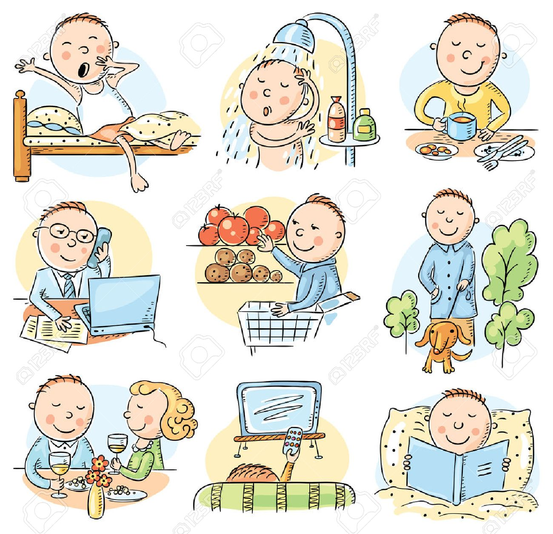
What did he do yesterday?

Slide 2
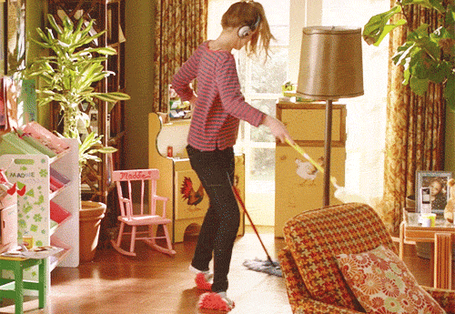
cleaned the room
clean the room
vacuum吸塵
〔d〕
sweep掃
mop拖

Slide 3
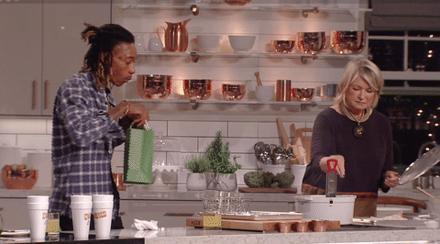
cooked dinner
cook dinner
〔t〕
宵夜
midnight snack late night meal

Slide 4
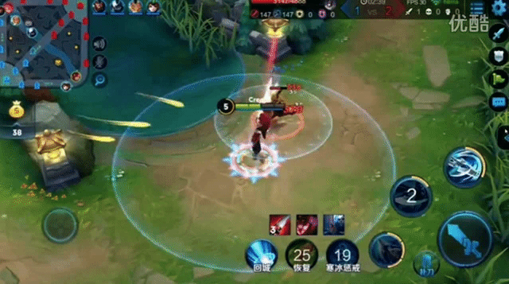
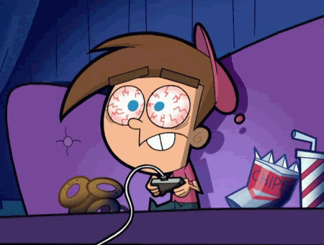
hyphen連字符號
play on-line games
played on-line games
〔d〕

Slide 5
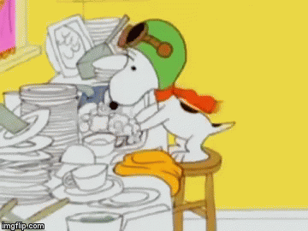
washed the dishes
wash the dishes
〔t〕
do the dishes

Slide 6
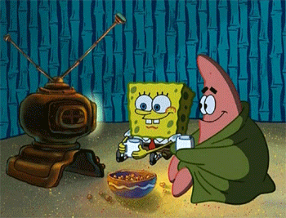
watch a movie
watched a movie
see a movie 是指在電影院看電影，而 watch a movie 則是在電視上、電腦上或其他可觀賞影片的裝置上看電影。
〔t〕

Slide 7
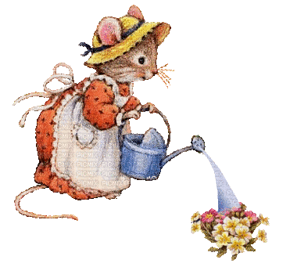
water the flowers
watered the flowers
〔d〕

Slide 8
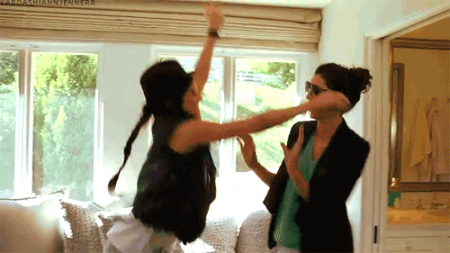
visit a friend
visited a friend
〔Id〕

Slide 9
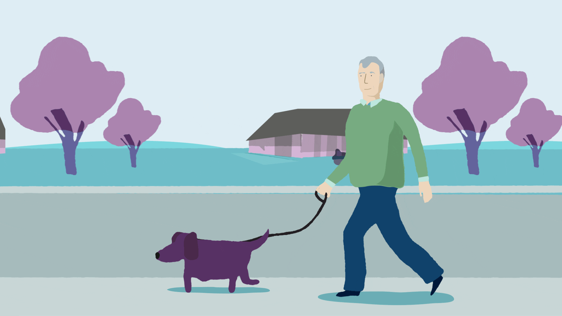
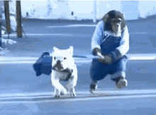
walked the dog
walk the dog
〔t〕

Slide 10
listened to music
listen to music
〔d〕

Slide 11
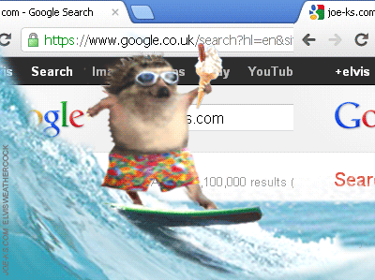
surfed the Internet
surf the Internet
〔t〕

Slide 12
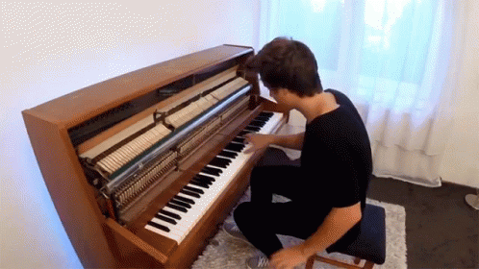
played the piano
play the piano
〔d〕
樂器前要加
the
play the flute吹笛
play the violin拉小提琴

Slide 13
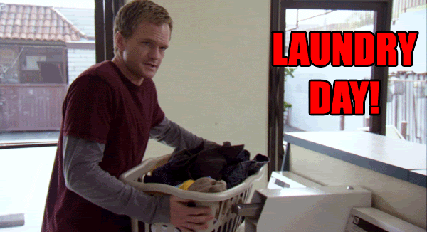
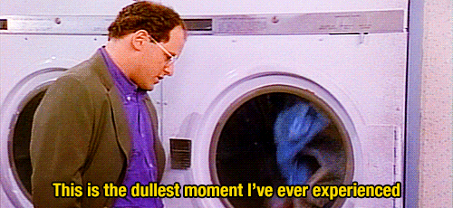
did the laundry
do the laundry

Slide 14
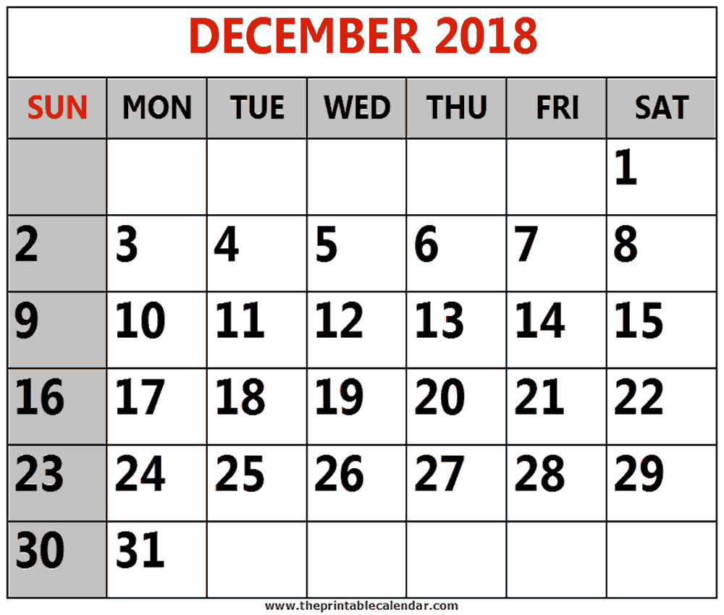
yesterday
today

Slide 15
last night
Dec
16th
Dec
17th

Slide 16
last Friday
today

Slide 17
last weekend
Saturday and Sunday,
or Friday evening until Sunday night.
today

Slide 18
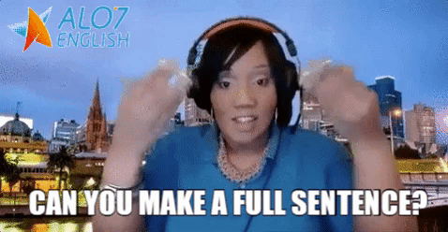

Slide 19
What did you do yesterday?
I surfed the Internet yesterday.

Slide 20
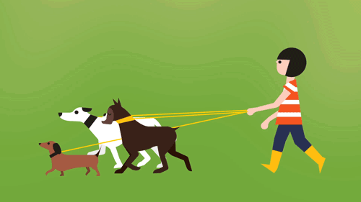
What did she do last night?
She walked the dogs last night.

Slide 21
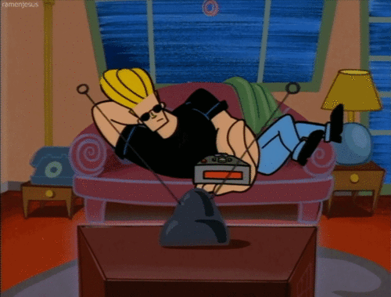
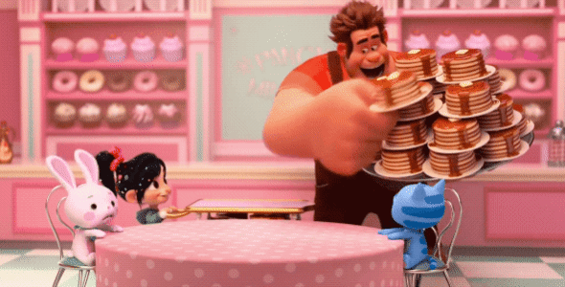
What did he do last Friday?
He watched a movie last Friday.

Slide 22
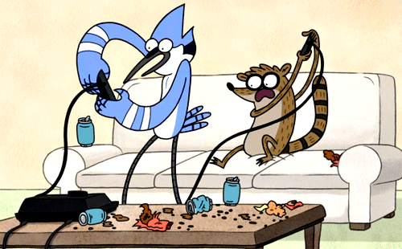
What did they do last weekend?
They played on-line games last weekend.

Slide 23
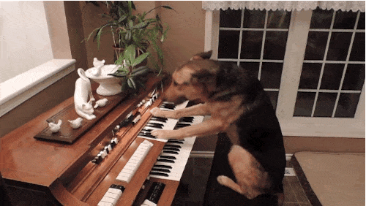
What did the dog do yesterday morning?
It played the piano yesterday morning.

Slide 24
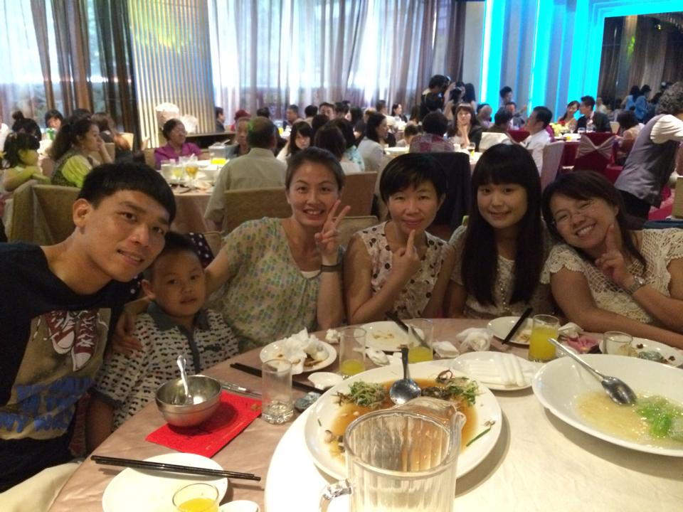
What did Mandy do last year?
She visited her friends last year.

Slide 25
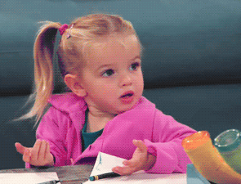
myself
friend

Slide 26
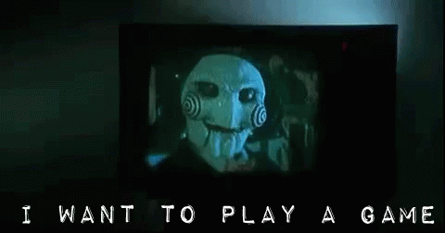

Slide 27
cleaned the room
cooked dinner
played on-line games
★ washed the dishes ★
watched a movie
watered the flowers
visited a friend
walked the dog
listened to music
surfed the Internet
played the piano
did the laundry

Slide 28
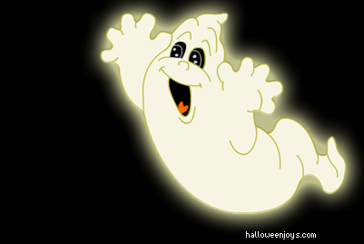
Catch the ghost!

Slide 29
1. Everybody gets a number and takes turns to go outside.
2. Use the sentence “What did you do last night?” to ask classmates.
3. Try to find out who says the answer “ I washed the dishes last night.”.
4. In the class, only the ghost can use “washed the dishes”. The other students should use another 11 activities.
5. The first person who catches the ghost can get 1 point.
6. The ghost can survive after 10 secs will get 2 points.

Slide 31
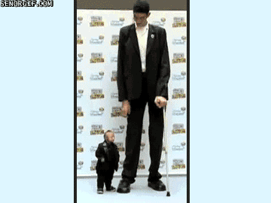
short
Chandra is _____,
but Sultan is _____.
tall

Slide 32
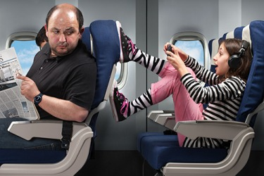
rude
The girl is _____,
but the woman is _____.
polite

Slide 33
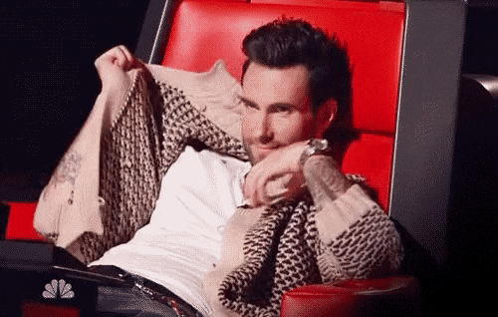
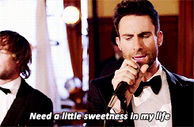
shy
Sometimes Adam Levine is _____,
but he is usually an _____ man.
outgoing

Slide 34
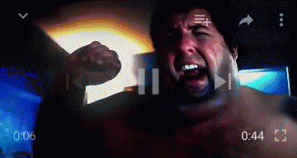
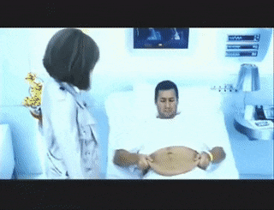
heavy
He was _____ before, but he is _____ now.
thin

Slide 35
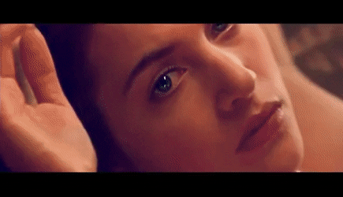
young
She was _____ before,
but she is _____ now.
old

Slide 36
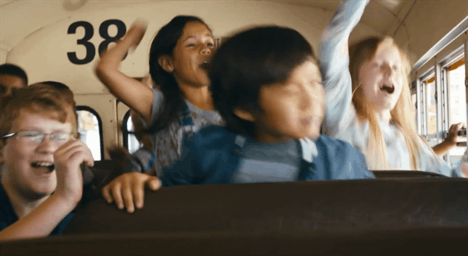
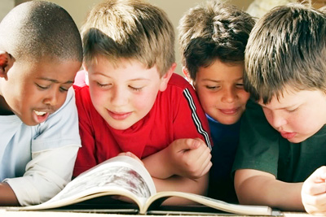
noisy
The kids were _____ before,
but they are _____ now.
quiet

Slide 37
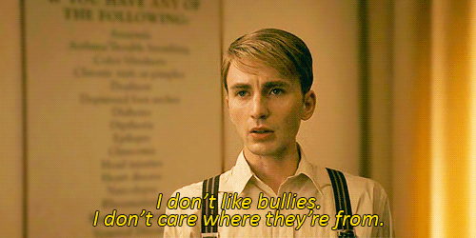
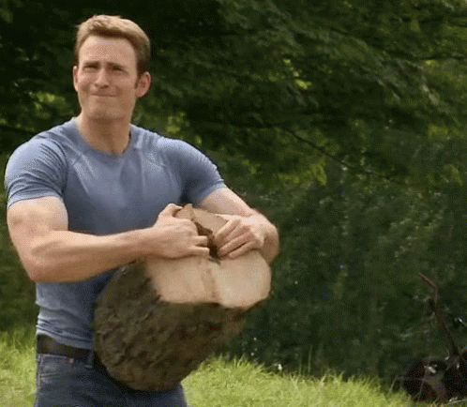
weak
Steve Rogers was _____ before,
but he is _____ now.
strong

Slide 38
messy
The room was _____ before,
but it is _____ now.
neat

